Slide 1
Stroke Detection
Chaitanya Padamata, Karthik Chellamuthu, Michael Dang

Slide 2
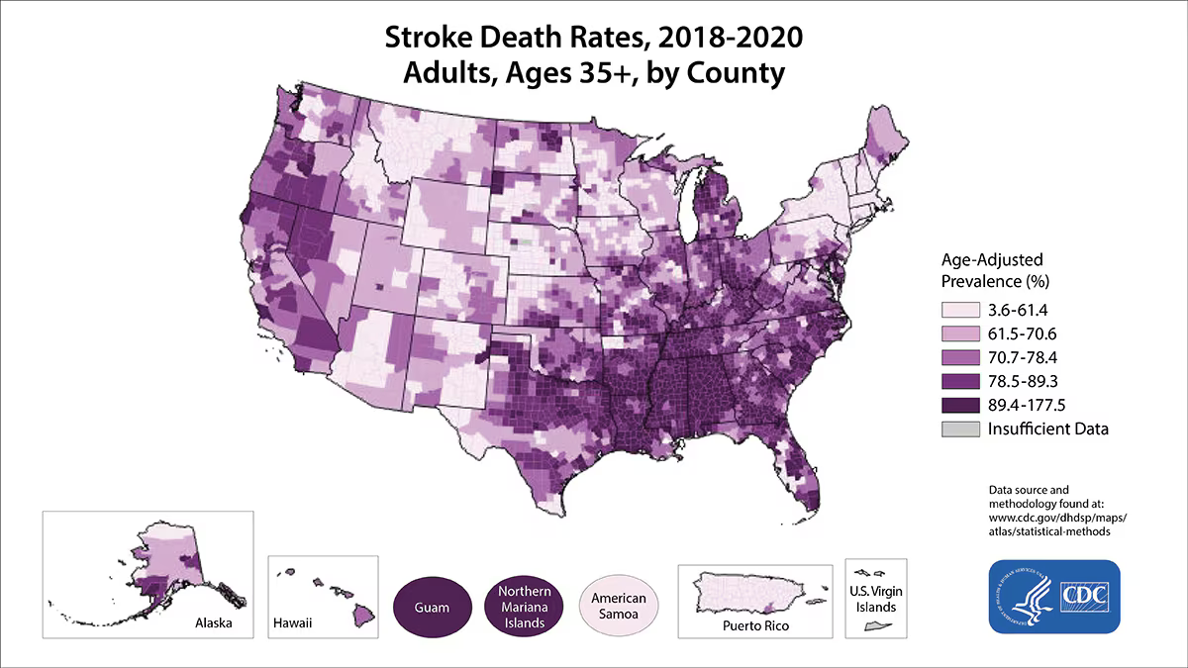
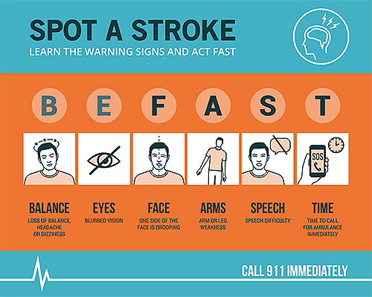
Summarize
Motivation: Early action is crucial in stroke cases, as the chances of survival significantly increase with immediate emergency treatment.
Problem Statement: Stroke is a medical emergency where delayed treatment can lead to severe disability or death. Many victims do not receive timely treatment due to delays in recognizing symptoms and accessing emergency care.
Proposal: The recent advancements in AI and machine learning present an opportunity to develop a platform that can detect potential strokes early.

Slide 3
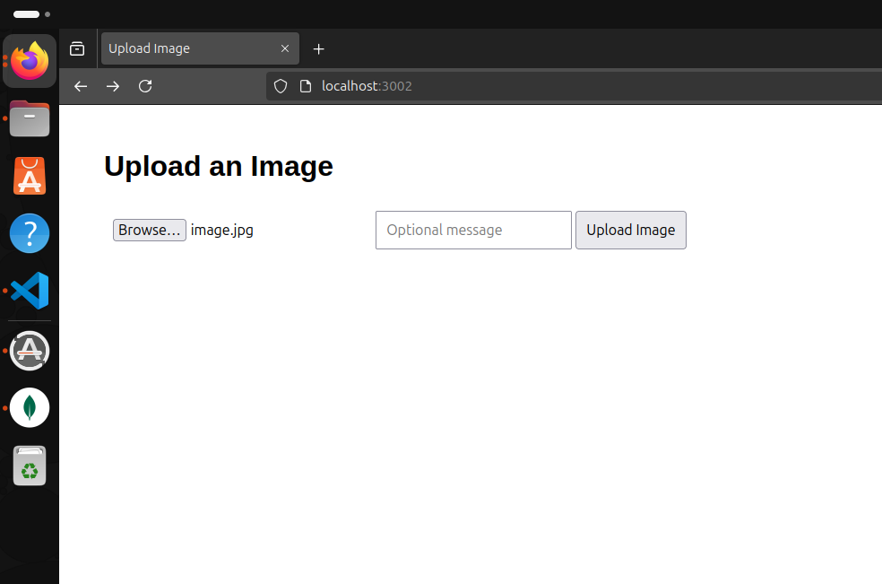
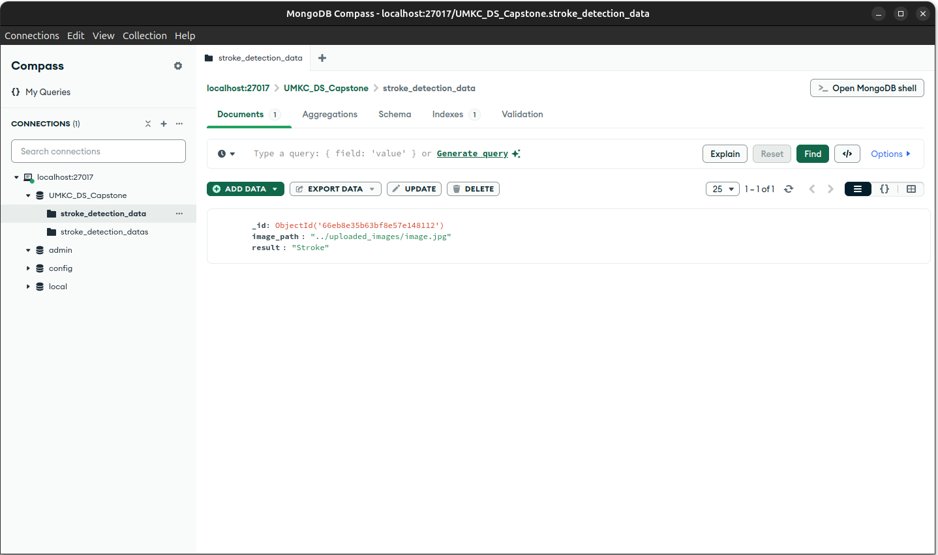
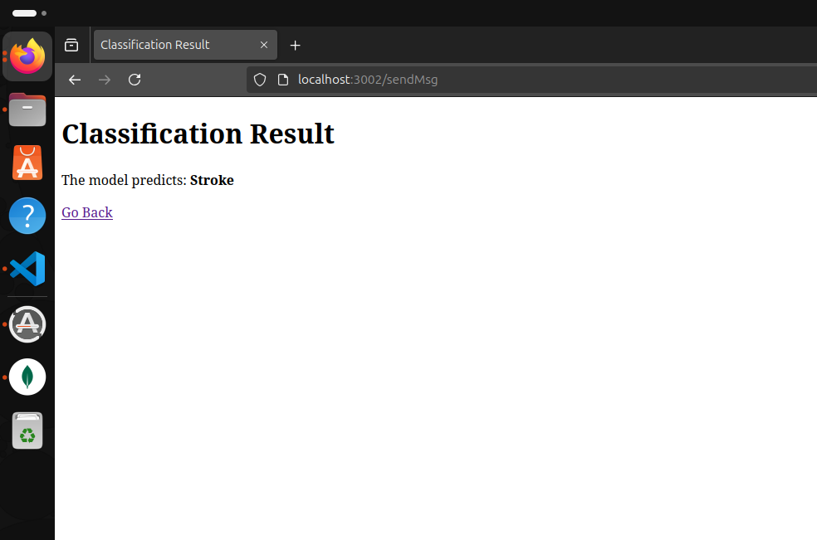
Progress
Basic set-up for triangle model is completed.

Slide 5
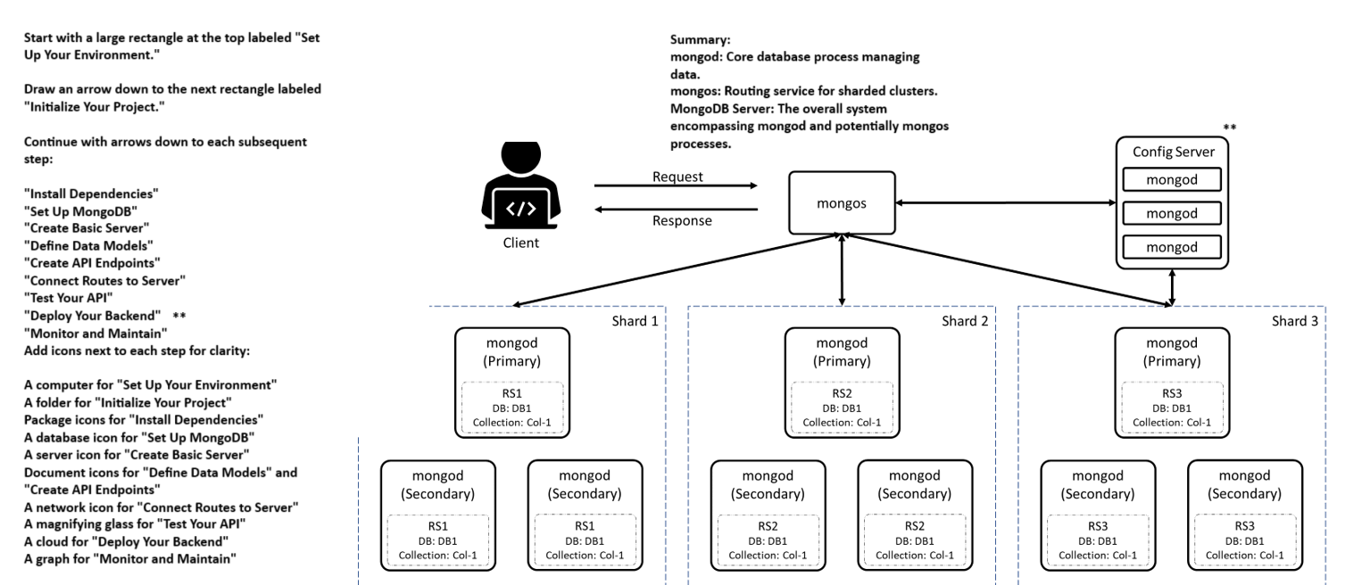
MongoDB Setup

Slide 8
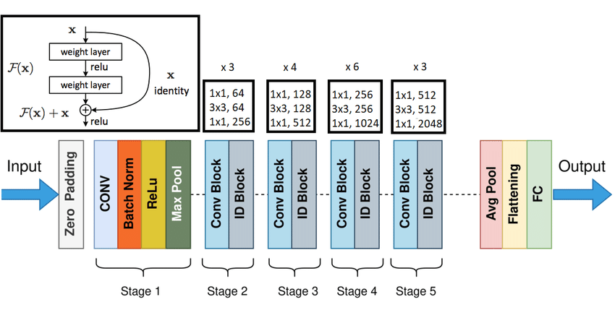
Technical
Since no suitable pre-existing models were found, we used a vanilla ResNet50 for the stroke classification task.
The dataset consists of a total of 3770 images. Data augmentation techniques were applied to the images to improve the overall accuracy of the model.

Slide 9
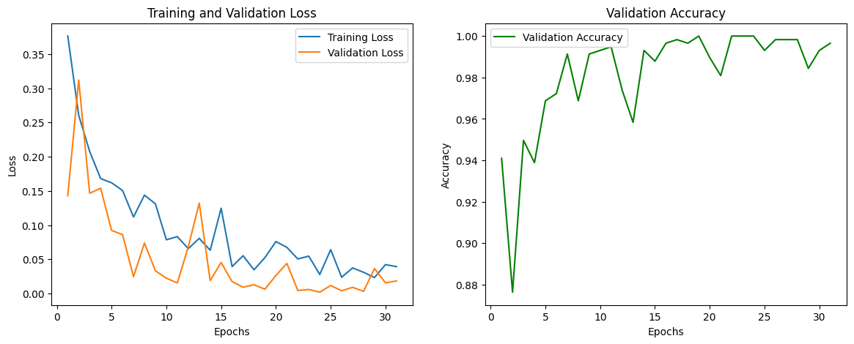
Result
The current prototype model, using ResNet50, has achieved a high classification accuracy of 99.65% over the stroke and no-stroke dataset. This strong performance indicates the model’s potential in reliably identifying stroke symptoms from facial images.

Slide 10
Plan + Next Steps
To enhance the website, we plan to integrate a camera that connects with the built-in machine learning model to directly analyze facial features and return the probability of a stroke. Instead of a messaging feature, an LLM-chatbot will be incorporated to interact with users and provide real-time assistance.
A threshold will be set, so if the model's stroke probability is between 90%-95%, an alert will appear. The user will then have the option to initiate an immediate 911 call and locate nearby emergency rooms by pressing a button, enhancing the platform's emergency response functionality.

Slide 11
Technical questions
Sample Technical Questions
What technical challenges have you encountered so far in optimizing the AI model for real-time stroke detection, and what strategies have you considered to address them?
How satisfied are you with the accuracy and performance of the current deep learning model (ResNet50), and do you believe the transition to a lightweight architecture like MobileNet would significantly impact detection capabilities?
From a user experience perspective, what features do you think are essential to implement in the frontend (e.g., live camera feed, real-time chatbot)? How can we make the platform more intuitive for non-technical users?
What are the potential risks or limitations of integrating real-time emergency response services (such as 911) into the platform, and how can we mitigate these challenges both technically and legally?
How do you envision expanding the dataset to improve model generalization across diverse demographics, and what methods would you suggest for ensuring data integrity and ethical usage?

Slide 12
Thank you

